Slide 1
SDN & NFV Lab 1: ONOS/Ryu + Mininet
Environment Setup & Basic Operation
Date: | 2019/02/18 (Mon.) 9:00
Deadline: | 2019/02/24 (Mon.) 23:59

Slide 2





Overview
Virtual Machine
ONOS
Use ONOS GUI to
see the topology
switch
host
host
Mininet

Slide 3
Outline
Environment Setup
VirtualBox Installation
Ryu Installation
ONOS Installation
Mininet Installation
Basic Operation
Activate basic Ryu APPs
Activate basic ONOS APPs
Create a topology controlled by Ryu/ONOS
[Way 1] Mininet CLI: “--topo” option
[Way 2] Custom Topology: Python script
Project1 requirements

Slide 4
Outline
Environment Setup
VirtualBox Installation
Ryu Installation
ONOS Installation
Mininet Installation
Basic Operation
Activate basic Ryu APPs
Activate basic ONOS APPs
Create a topology controlled by Ryu/ONOS
Project1 requirements

Slide 5
Environment Setup
VirtualBox & ONOS & Mininet

Slide 6
Outline
Environment Setup
VirtualBox Installation
Ryu Installation
ONOS Installation
Mininet Installation
Basic Operation
Activate basic Ryu APPs
Activate basic ONOS APPs
Create a topology controlled by Ryu/ONOS
Project1 requirements

Slide 7
Prepare a Operational Environment
VirtualBox: Open source cross-platform virtualization application
Use Ubuntu 16.04
Recommended Hardware requirement
2 Cores
4G RAM
40G HDD
For more information, please refers to:
[File] SDN_Environment_Setup.pptx

Slide 8
Outline
Environment Setup
VirtualBox Installation
Ryu Installation
ONOS Installation
Mininet Installation
Basic Operation
Activate basic Ryu APPs
Activate basic ONOS APPs
Create a topology controlled by Ryu/ONOS
Project1 requirements

Slide 9
Ryu Installation
Install dependencies
Install Ryu from source code
For more information, please refer to:
Github
Ryu Document
Ryubook 1.0 (For your reference of future work on applications)
$ sudo apt install gcc python-dev libffi-dev libssl-dev libxml2-dev libxslt1-dev zlib1g-dev
$ git clone git://github.com/osrg/ryu.git
$ cd ryu; pip install .

Slide 10
Outline
Environment Setup
VirtualBox Installation
Ryu Installation
ONOS Installation
ONOS Dependencies Installation
Bazel Installation
ONOS Installation
Mininet Installation
Basic Operation
Activate basic Ryu APPs
Activate basic ONOS APPs
Create a topology controlled by Ryu/ONOS
Project1 requirements

Slide 11
ONOS Dependencies Installation
Java dependency
Other dependencies
$ sudo apt-get install software-properties-common -y && \
sudo add-apt-repository ppa:webupd8team/java -y && \
sudo apt-get update && \
echo "oracle-java8-installer shared/accepted-oracle-license-v1-1 select true" | sudo debconf-set-selections && \
sudo apt-get install oracle-java8-installer oracle-java8-set-default -y
$ sudo apt-get install git zip curl unzip python

Slide 12
Bazel Installation
Install required packages
Download Bazel
Run the installer
“--user”: Make Bazel executable installed in $HOME/bin directory.
Add $HOME/bin in default paths in ~/.bashrc file
$ sudo apt-get install pkg-config zip g++ zlib1g-dev unzip python
$ wget -c https://github.com/bazelbuild/bazel/releases/download/0.22.0/bazel-0.22.0-installer-linux-x86_64.sh
$ chmod +x bazel-0.22.0-installer-linux-x86_64.sh
$ ./bazel-0.22.0-installer-linux-x86_64.sh --user
export PATH="$PATH:$HOME/bin"

Slide 13
ONOS Installation
Download ONOS code & checkout to version 1.15.
Build ONOS
Run ONOS.
Stop ONOS
For more information, please refer to:
Installing Bazel on Ubuntu
Developer Quick Start
$ cd ~/ && git clone https://gerrit.onosproject.org/onos
$ cd onos && git checkout onos-1.15
$ bazel build onos
$ bazel run onos-local -- clean debug
<ctl + C>
Notes:
Clean debug 作用

Slide 14
Outline
Environment Setup
VirtualBox Installation
Ryu Installation
ONOS Installation
Mininet Installation
Basic Operation
Activate basic Ryu APPs
Activate basic ONOS APPs
Create a topology controlled by Ryu/ONOS
Project1 requirements

Slide 15
Mininet Installation
Download from source code & build Mininet
Exit mininet shell
Clean the environment
$ cd ~/ && git clone https://github.com/mininet/mininet
$ cd mininet
$ util/install.sh -a
mininet> exit
$ sudo mn -c

Slide 16
Outline
Environment Setup
VirtualBox Installation
Ryu Installation
ONOS Installation
Mininet Installation
Basic Operation
Activate basic Ryu APPs
Activate basic ONOS APPs
Create a topology controlled by Ryu/ONOS
Project1 requirements

Slide 17
Basic Operation
ONOS APPs & Custom Topology

Slide 18
Outline
Environment Setup
VirtualBox Installation
Ryu Installation
ONOS Installation
Mininet Installation
Basic Operation
Activate basic Ryu APPs
Activate basic ONOS APPs
Create a topology controlled by Ryu/ONOS
Project1 requirements

Slide 19
Activate basic Ryu APPs
Run Ryu controller and applications
In this project, we are going to use a repository named ryu-starter-kit provided by SDN Hub.
https://bitbucket.org/sdnhub/ryu-starter-kit
The repository contains applications included learning switch function, web server and so on.
Follow the installation instructions, and simple run the script
$ ryu-manager yourapp.py
$ ./ryu/app/sdnhub_apps/run_sdnhub_apps.sh

Slide 20
Outline
Environment Setup
VirtualBox Installation
Ryu Installation
ONOS Installation
Mininet Installation
Basic Operation
Activate basic Ryu APPs
Activate basic ONOS APPs
Create a topology controlled by Ryu/ONOS
Project1 requirements

Slide 21
Activate basic ONOS APPs
Run ONOS in localhost.
Login into ONOS CLI
Activate applications by ONOS CLI
$ bazel run onos-local -- clean debug
$ tools/test/bin/onos localhost
onos> app activate org.onosproject.openflow
onos> app activate org.onosproject.fwd

Slide 22
Outline
Environment Setup
Basic Operation
Activate basic Ryu APPs
Activate basic ONOS APPs
Create a topology controlled by Ryu/ONOS
[Way 1] Mininet CLI: “--topo” option
Create a topology controlled by ONOS
Topology in ONOS GUI
Hosts in ONOS GUI
[Way 2] Custom Topology: Python script
Project1 requirements

Slide 23

Create a topology controlled by Ryu/ONOS
Run Mininet controlled by ONOS
By default, a switch would have one host
$ sudo mn --topo=linear,3 --controller=remote,ip=127.0.0.1:6653
*** Creating network
*** Adding controller
*** Adding hosts:
h1 h2 h3
*** Adding switches:
s1 s2 s3
*** Adding links:
(h1, s1) (h2, s2) (h3, s3) (s2, s1) (s3, s2)
*** Configuring hosts
h1 h2 h3
*** Starting controller
c0
*** Starting 3 switches
s1 s2 s3 ...
*** Starting CLI:
mininet>
ONOS
s1
s2
s3
h1
h2
h3

Slide 24
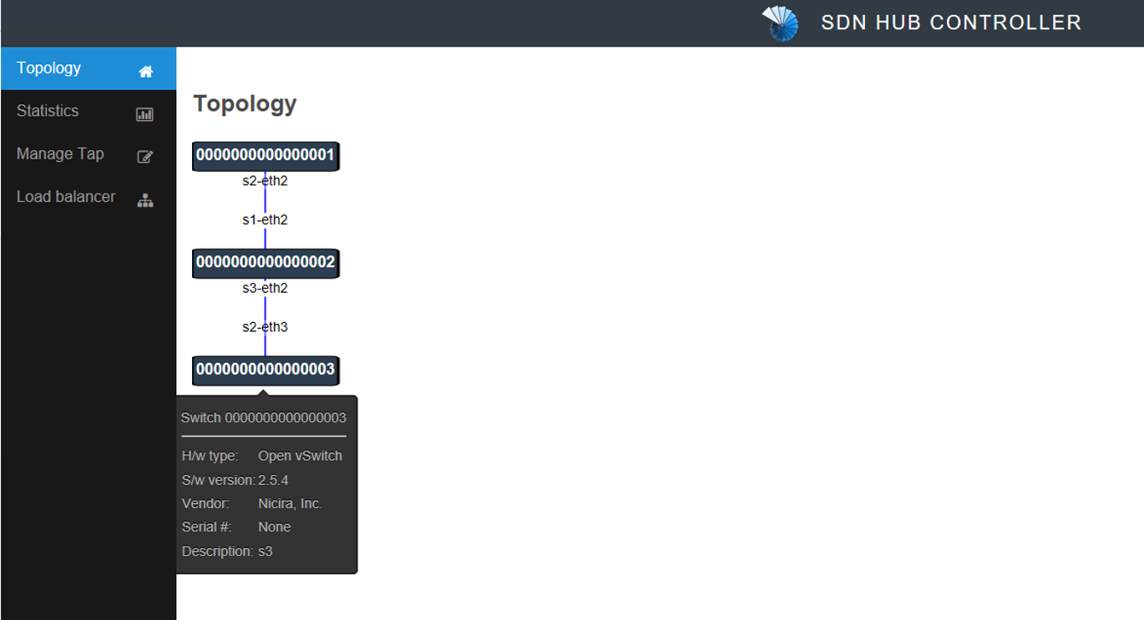
Topology in Ryu GUI (SDN Hub)
Visit http://localhost:8080 on your web browser
Use IE, Edge or FireFox if Google Chrome cannot show the topology

Slide 25
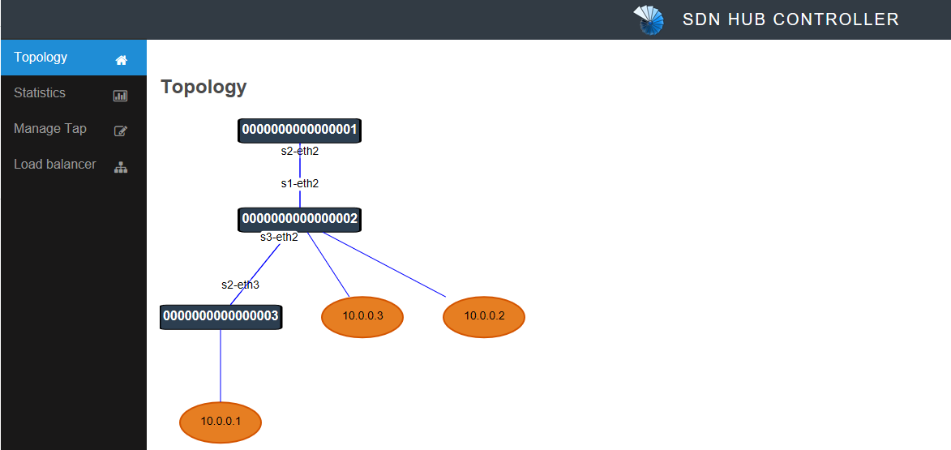
See hosts in Ryu GUI (SDN Hub)
Use “pingall” in Mininet shell
Refresh the web page if hosts were not shown in few seconds
mininet> pingall
*** Ping: testing ping reachability
h1 -> h2 h3
h2 -> h1 h3
h3 -> h1 h2
*** Results: 0% dropped (6/6 received)
There is something wrong with host probing!
Notes:
https://bitbucket.org/sdnhub/ryu-starter-kit/src/7a162d81f97d080c10beb15d8653a8e0eff8a469/host_tracker_rest.py?at=master&fileviewer=file-view-default#host_tracker_rest.py-66:67

Slide 26
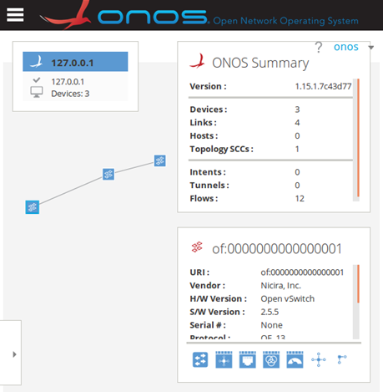
Topology in ONOS GUI
Open ONOS web page
or alternatively visit http://localhost:8181/onos/ui
user/password: onos/rocks
$ tools/test/bin/onos-gui localhost
s3
s2
s1
Switch information
Notes:
說明MININET會預設掛HOST+圖
截圖上方不需要

Slide 27
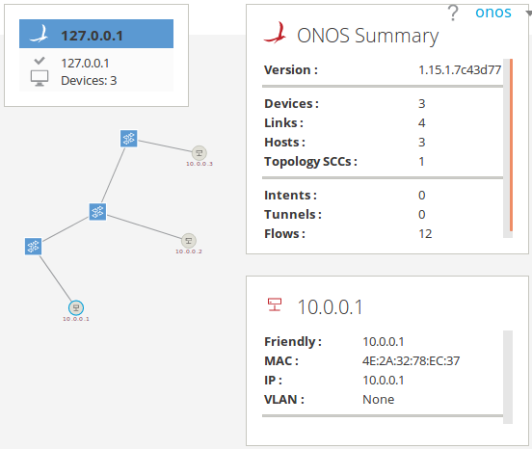
See hosts in ONOS GUI
Use “pingall” in Mininet shell
Type “h” in ONOS GUI to see hosts
mininet> pingall
*** Ping: testing ping reachability
h1 -> h2 h3
h2 -> h1 h3
h3 -> h1 h2
*** Results: 0% dropped (6/6 received)
s3
h3
s2
s1
h2
Host information
h1
Notes:
Us pingall to
Onos detect host only when host send packets

Slide 28
Outline
Environment Setup
Basic Operation
Activate basic Ryu APPs
Activate basic ONOS APPs
Create a topology controlled by Ryu/ONOS
[Way 1] Mininet CLI: “--topo” option
[Way 2] Custom Topology: Python script
Customizing “mn” using “--custom” files
Python Script
Add new CLI command in a “--custom” file
Project1 requirements

Slide 29
Customizing “mn” using “--custom” files
Invoke your own custom topology
“mn” adds new features which can be invoked
Need to define a dict in “--custom” file (sample.py) based on the option type
dict’s key are short names passed to the appropriate option
dict’s value are the corresponding subclasses, constructors or functions:
“topos={}” allows the file to be imported by “--topo” option
$ sudo mn --custom=sample.py --topo=mytopo
option | dict name | Key:value
--topo | topos | ‘short name’: Topo constructor
class MyTopo( Topo ):
def build( self, ...):
...
topos = { 'mytopo': MyTopo }
Add “MyTopo” class (or constructor) to the “topos” dictionary, allowing it to be used with the “--topo” option

Slide 30
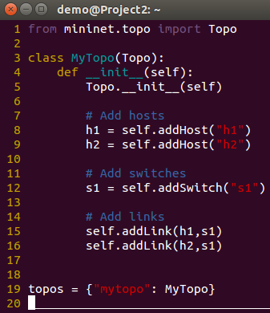
Python Script
Edit “sample.py” and run the file
$ sudo mn --custom=sample.py --topo=mytopo \
> --controller=remote,ip=127.0.0.1,port=6653
s1(switch)
h1(host)
h2(host)

Slide 31
Add new CLI command in a “--custom” file
Define a function in your Python script
The command function that added to CLI should have “do_” prefix
The above function adds a “mycmd” command to Mininet CLI
def mycmd( self, line ):
"mycmd is an example command to extend the Mininet CLI"
net = self.mn
output( 'mycmd invoked for', net, 'with line', line, '\n' )
CLI.do_mycmd = mycmd
$ sudo mn --custom <python_script.py> -v output
mininet> help mycmd
mycmd is an example command to extend the Mininet CLI
mininet> mycmd foo
mycmd invoked for <mininet.net.Mininet object at 0x7fd7235fb9d0> with line foo

Slide 32
Outline
Environment Setup
VirtualBox Installation
Ryu Installation
ONOS Installation
Mininet Installation
Basic Operation
Activate basic Ryu APPs
Activate basic ONOS APPs
Create a topology controlled by Ryu/ONOS
Project1 requirements
Answer Questions
Write a custom Topology
Add your own CLI command

Slide 33
Project1 requirements
ONOS APPs & Custom Topologies & Add a new command

Slide 34
Answer Questions - Ryu
Activate Ryu APPs
Please find all APPs activated in run_sdnhub_apps.sh.
Observe listening ports.
Openflow defines the TCP port for connection between controller and switch. What is the number of these ports?

Slide 35
Answer Questions - ONOS
Activate ONOS APPs
When activating “org.onosproject.openflow”, what are the APPs also be activated?
Which APP enables hosts to ping each other?
Observe listening ports.
Openflow defines the TCP port for connection between controller and switch. What is the number of these ports?
Which APP enables the TCP port be listening?

Slide 36
Write a Custom Topology
Use the following command to execute your script:
The class name of the topology in Python script is required to be “Project1_Topo_<studentID>”
Try to write a script to build the following topology:
$ sudo mn --custom=project1_<studentID>.py \
> --topo=topology_<studentID> \
> --controller=remote,ip=127.0.0.1:6653
s3(switch)
s4(switch)
s1(switch)
s2(switch)
h1(host)
h2(host)
h3(host)
h4(host)

Slide 37
An example: Using studentID: 0748787
You should use the following command:
Class name in script should be: Project1_Topo_0748787
Take a screenshot with switch name and hosts
$ sudo mn --custom=project1_0748787.py \
> --topo=topology_0748787 \
> --controller=remote,ip=127.0.0.1:6653
of:000…
of:000…
of:000…
of:000…
<hostIP>
<hostIP>
<hostIP>
<hostIP>

Slide 38
Add your own CLI command
Write a command to add a host to specific switch.
The command format should be:
The host numbering should be in order
The host IP should assign in format: 10.0.0.<host_numbering>
The command should designate new host to specific switch.
mininet> <your_command> <switch_name>
s3(switch)
s4(switch)
h5(host)
h6(host)
s1(switch)
s2(switch)
h1(host)
h2(host)
h3(host)
h4(host)

Slide 39
An example: “addHostToSwitch” command
With the above topology wrote before.
Add two more hosts to s3 and s4
mininet> addHostToSwitch s3
mininet> pingall
*** Ping: testing ping reachability
h1 -> h2 h3 h4 h5
h2 -> h1 h3 h4 h5
h3 -> h1 h2 h4 h5
h4 -> h1 h2 h3 h5
h5 -> h1 h2 h3 h4
*** Results: 0% dropped (20/20 received)
mininet> addHostToSwitch s4
mininet> pingall
*** Ping: testing ping reachability
h1 -> h2 h3 h4 h5 h6
h2 -> h1 h3 h4 h5 h6
h3 -> h1 h2 h4 h5 h6
h4 -> h1 h2 h3 h5 h6
h5 -> h1 h2 h3 h4 h6
h6 -> h1 h2 h3 h4 h5
*** Results: 0% dropped (30/30 received)
ca.nctu.edu.tw

Slide 40
Additional Description

Slide 41
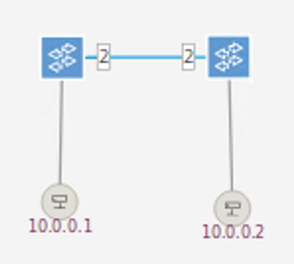

Network Topology for Emulation
Mininet uses the root namespace, the only way to run OVS
Observe the linear topology with two devices
s1 has two interfaces: s1-eth1 and s1-eth2
eth0
Root namespace
Software switch
socket
socket
s1-eth1
s1-eth2
s2-eth2
s2-eth1
s1-eth2
s2-eth2
veth
veth
s1
s2
h1-eth0
h2-eth0
s1-eth1
s2-eth1
Process 1
Process 2
h1(host)
h2(host)
h1 namespace
h2 namespace

Slide 42
Recommended Procedure
Add a switch and a host in the topology
Add a link between the switch and the host
Find the new interface of the switch
Attach the interface to the switch
Set IP for the host
Mininet API
mininet.net.Mininet Class
mininet.node.Node Class
mininet.node.OVSSwitch Class

Slide 43
Submit
Report & Python script

Slide 44
Submit to e3
Files
A python script: <You have to name it>.py
A report: project1_studentID.pdf
Record your process (especially your command)
Take screenshots (ONOS GUI or CLI) and explain or mark them
Write down what you learn or solve
Submit
Upload “.zip” file to e3
Named: project1_studentID.zip
Wrong file name or format would not be scored
Demo
Show your own command to add new host to specific switch.

Slide 45
Thank you
Q & A

